Slide 1

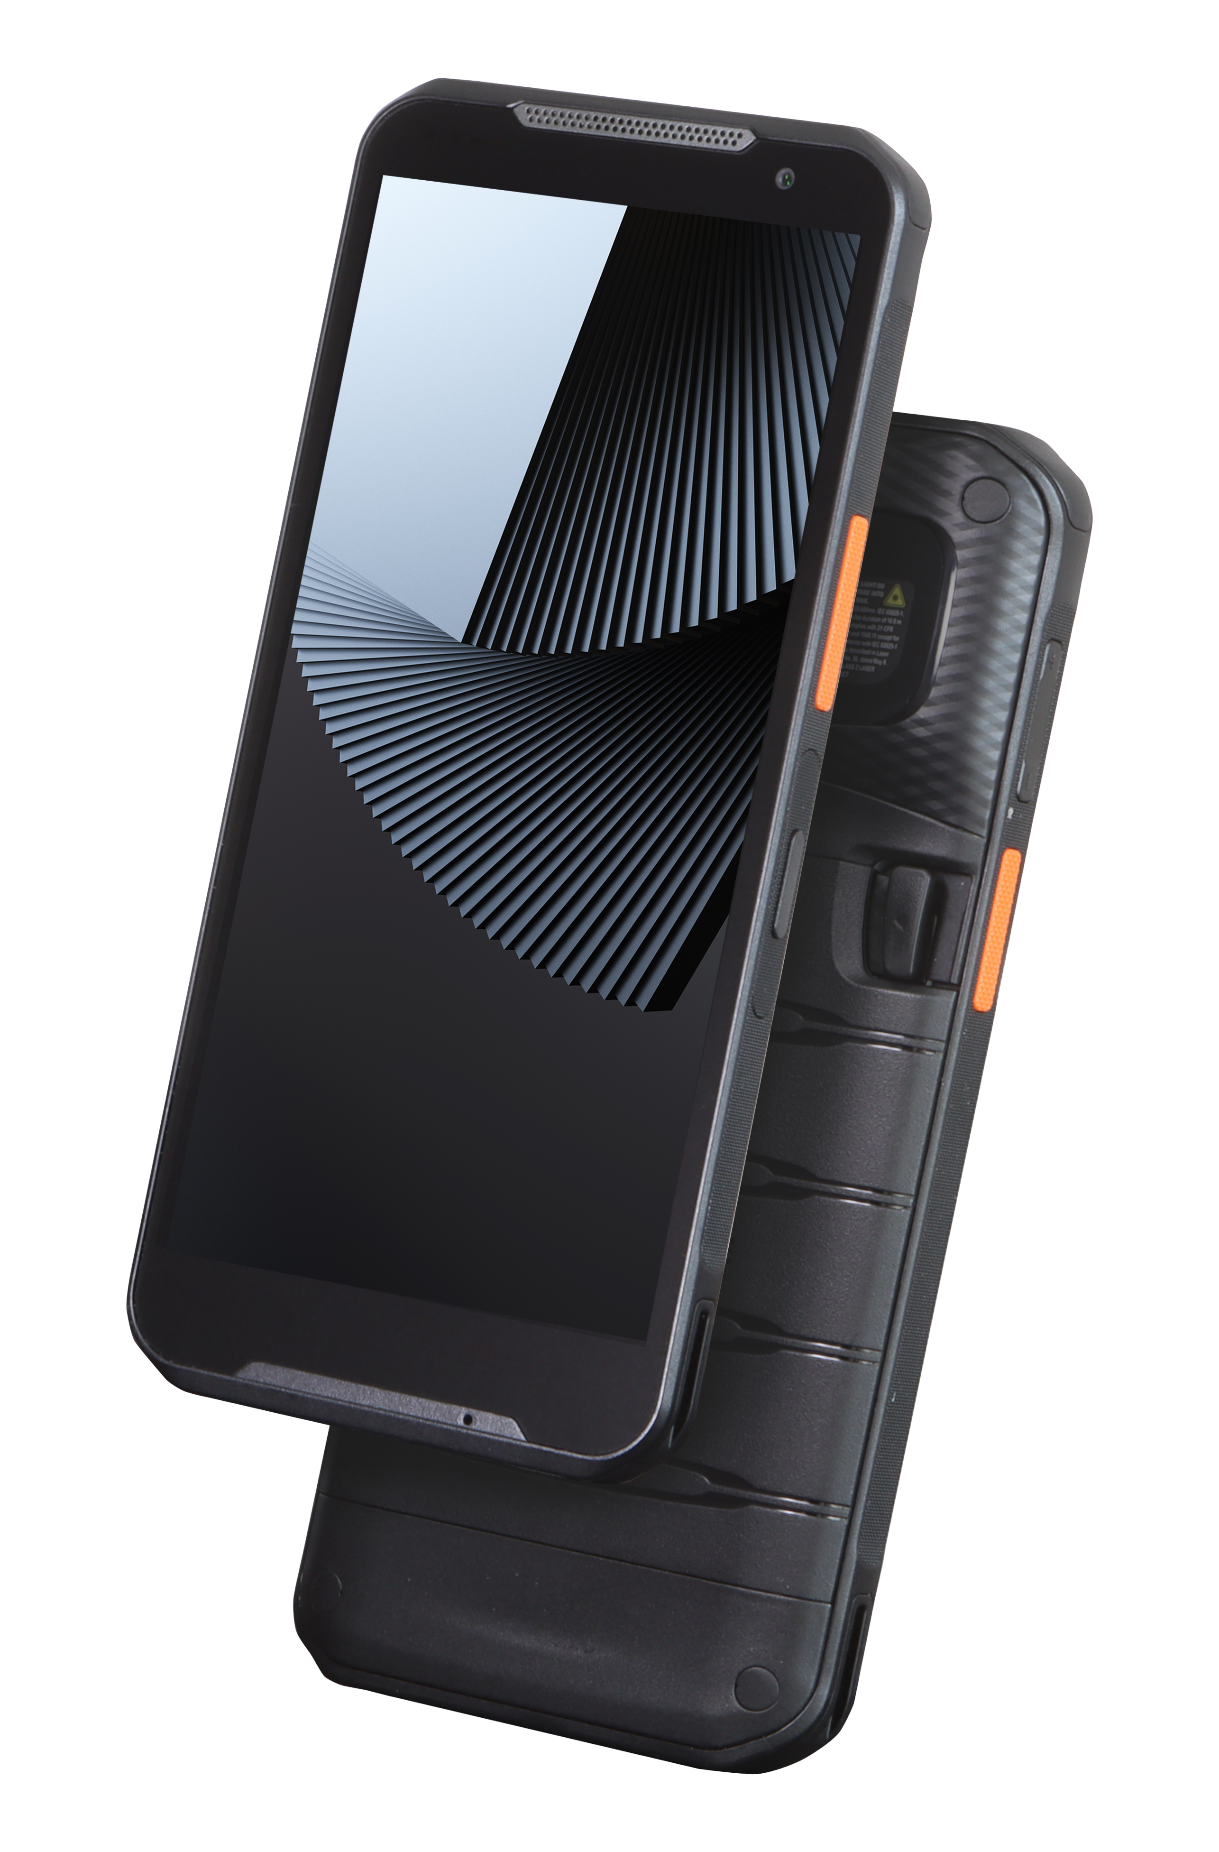
MF52e
MF52 DNA, Perfect Balance for the Field
Copyright © 2026 Point Mobile Co., Ltd. All rights reserved.
Point Mobile Co., Ltd. is the designer and manufacturer of mobile computers.

Slide 2














At-a-glance – MF52e
Qualcomm
Octa-core, 2.4 GHz
Android 15
(Upgradeable to 19)
1080 X 2160 FHD+
16.45 mm Slim, 266.5g
Android 15
(Upgradeable to 18)
IP68
MIL-STD-810H
Wi-Fi 6E, 5G, Bluetooth 5.2
Camera | 13 MP (R), 8 MP (F)
2D Scan | Straight, 20 ° 60 °
PD 3.0
Fast-charging
1.8 m (6 ft.)
Drop Resistant
4,670 / 7,000 mAh Hot-Swappable
Battery
1.5 m (4.9 ft.) Drop Tested IP65, IP68, MIL-STD-810H
In-Display NFC
Tag Type 1-5

Slide 3
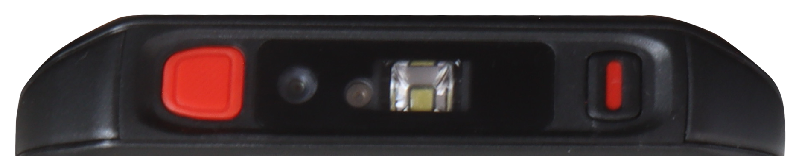


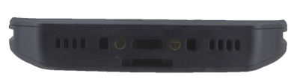
Specifications
2D Scanner
8 MP Front /
13 MP Rear Camera
SOS Button
Scan /
Volume Button
Programmable
Button
79 mm
( 3.11 in. )
16.45 mm
( 0.65 in.)
168 mm
( 6.61 in.)
Type C Port

Slide 4

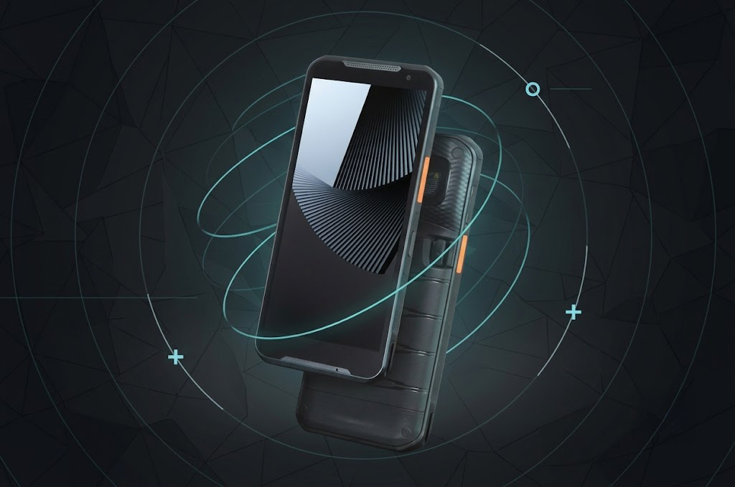
Highlights
Reliable Everyday Performance
Rugged yet Stylish Design
Qualcomm 2.4 GHz Octa-core Processor
6 GB or 8 GB RAM / 64 GB or 128 GB Storage
Android 15 (Upgradable to 19)
16.45 mm Slim, 266.5 g Lightweight
1.5 m Drop Tested, MIL-STD-810H Certified
IP65 & IP68
Field-Ready Data Capture
Stay Connected, Anywhere
2D Scanner (Stright / 20 ° / 60°)
In-Display NFC
13 MP Rear / 8 MP Front Camera
Wi-Fi 6E, 5G, and Bluetooth 5.2
Dual SIM (Nano + eSIM)
Seamless Workflow
4,670 mAh (STD), 7,000 mAh (EXT)
Hot-Swappable Battery
PD 3.0 Fast Charging (90% in 90 min)
Programmable Button, Dedicated PTT
SOS Button

Slide 5

Stay Ahead Of Change
Point Mobile’s Long-Term Android Support
Technology moves fast—too fast for most devices to keep up.
Upgrades, new networks, shifting app standards.
MF52e doesn’t follow—it leads from one step ahead.
A foundation built for tomorrow requires a system that evolves long after deployment. Powered by Android 15 (upgradable to 19), MF52e stays compatible with future standards and applications—helping you reduce TCO and stay prepared for whatever comes next.

Slide 6



Core Power for Every Challenge
MF52e, powered by the Qualcomm QCM4490 Octa-core 2.4 GHz processor,
is engineered for the core demands of the frontline. It delivers consistent, responsive performance for essential workflows.
Optimized for extensive workplaces, MF52e is the smart, scalable choice to empower your entire team with reliability.

Slide 7
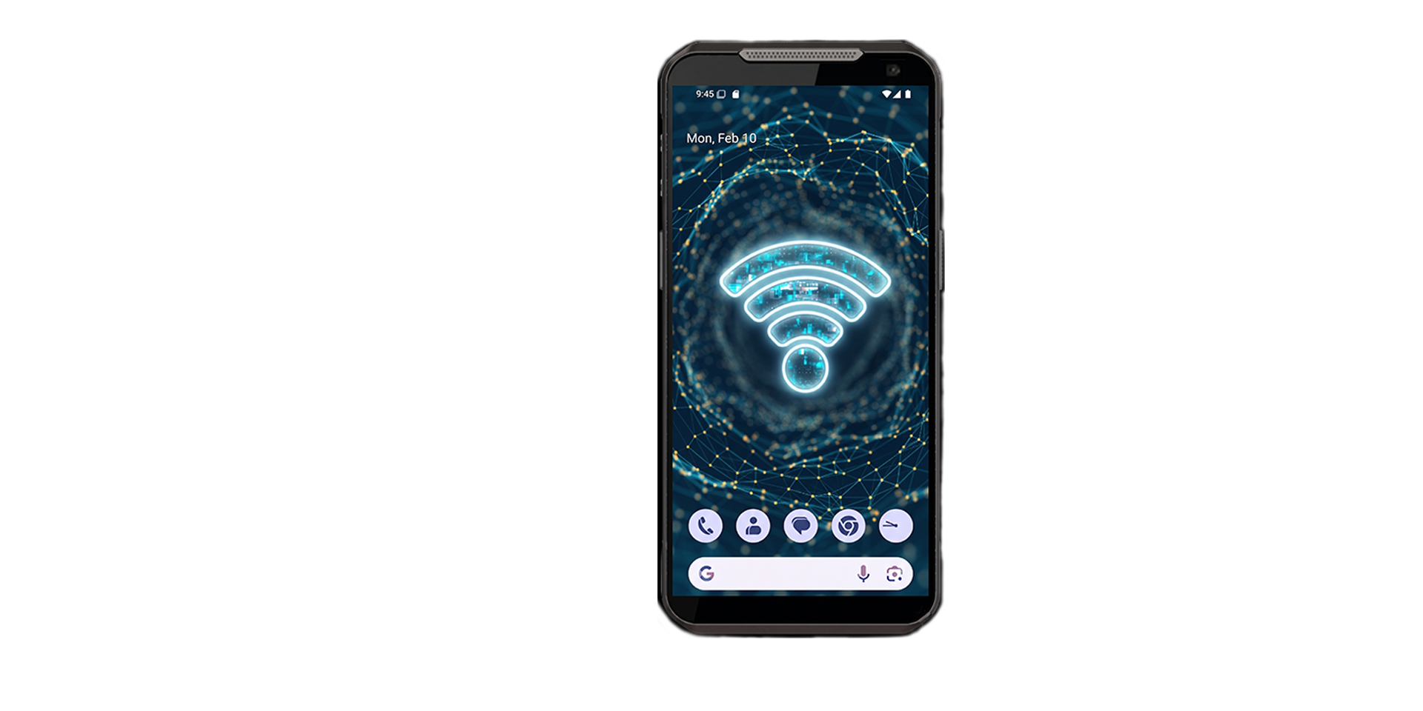
Seamlessly Optimized,
Powerfully Connected
WiFi 6E
Powered by the Qualcomm WCN6856, MF52e accesses the 6GHz spectrum to provide a dedicated, interference-free lane for essential business data. It ensures ultra-responsive performance, maintaining a steady workflow even in environments with extreme device density.
5G
Supports high-capacity Sub-6GHz networks to provide ultra-low latency and seamless real-time data synchronization. It empowers field teams with constant, high-speed connectivity, ensuring uninterrupted productivity and fast decision-making regardless of location.
Bluetooth 5.2
MF52e handles multiple peripherals with ease. Leveraging EATT technology, MF52e enables seamless multitasking with high-speed responsiveness, even when paired with several devices at once. Enhanced by LE Power Control, it ensures data integrity, connection stability and maximizing battery life.

Slide 8
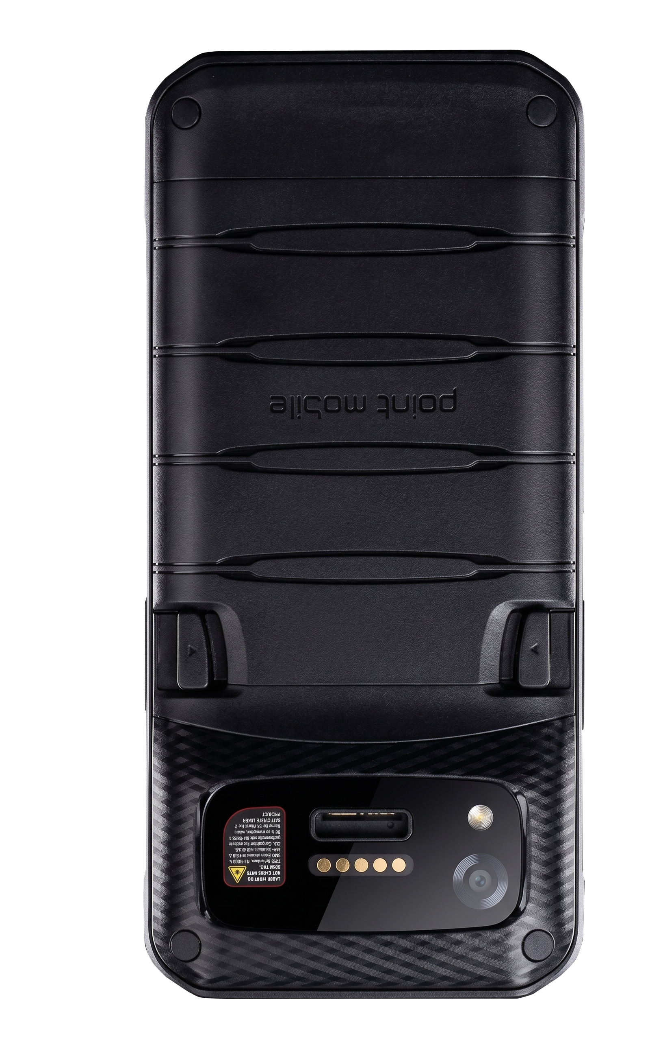
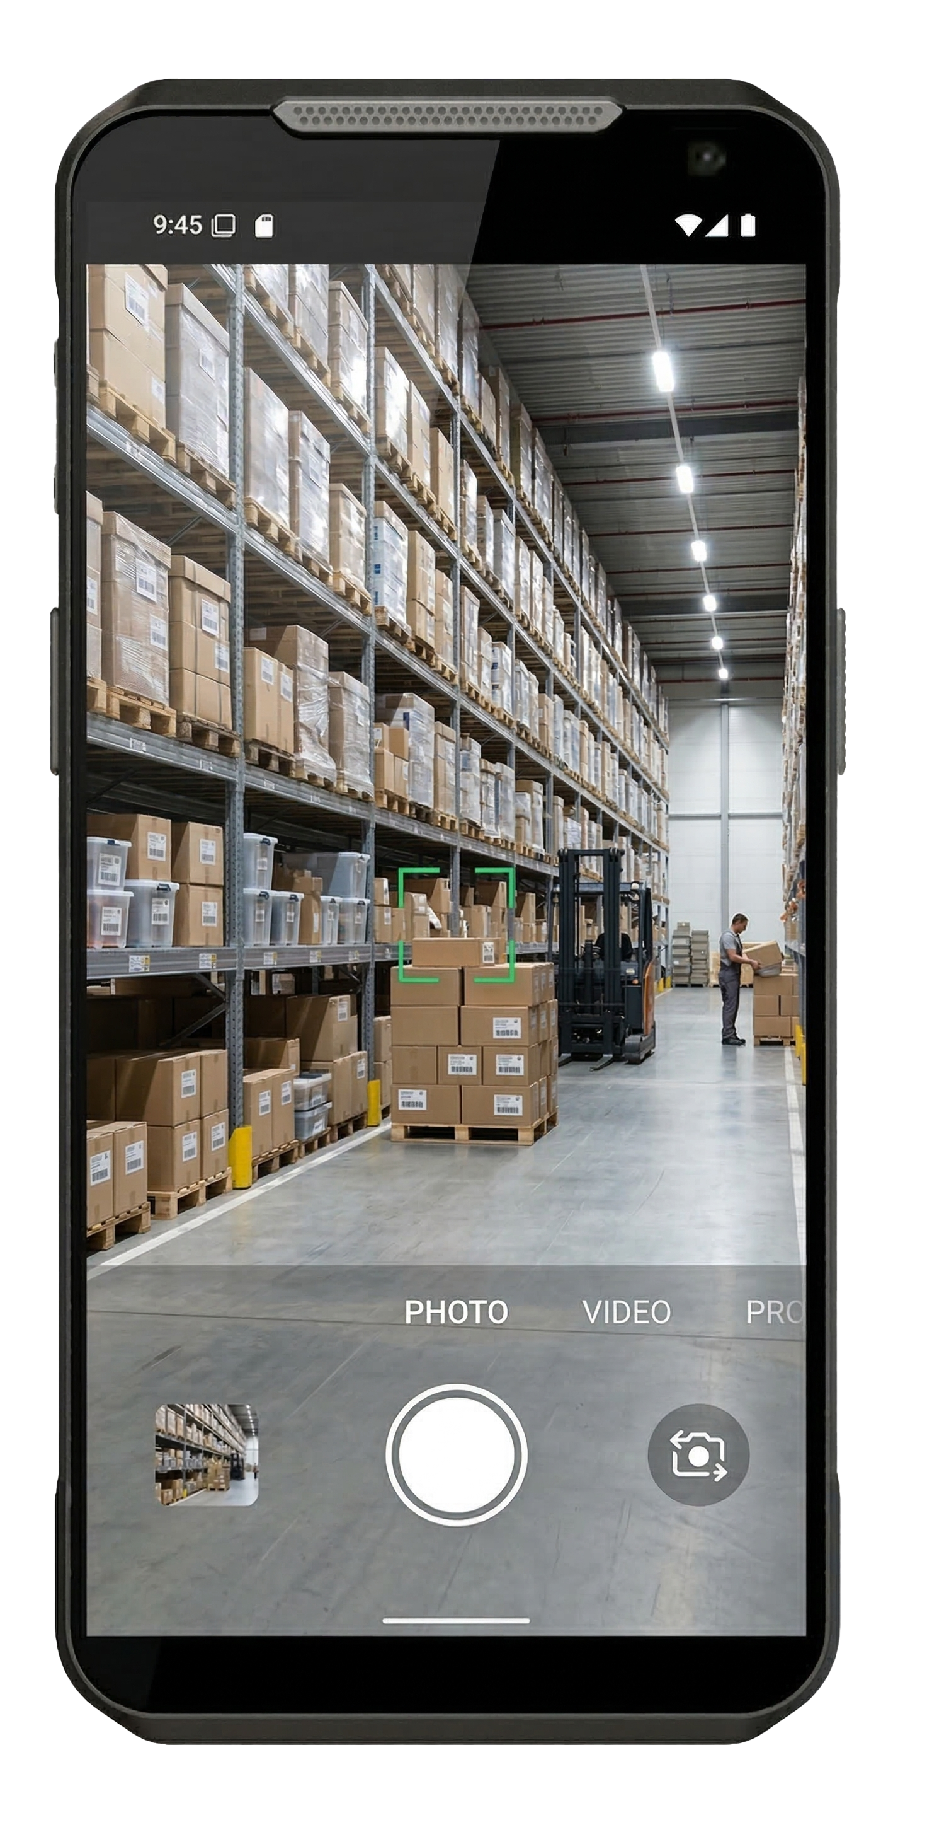
8 MP & 13 MP
Front-Rear Camera
MF52e features a 13 MP rear and 8 MP front camera, offering the practical performance required for daily field operations. The rear camera ensures reliable clarity for asset documentation and on-site evidence, while the front supports video communication and ID verification. Together, they deliver the essential imaging tools needed for consistent and accurate professional reporting.

Slide 9
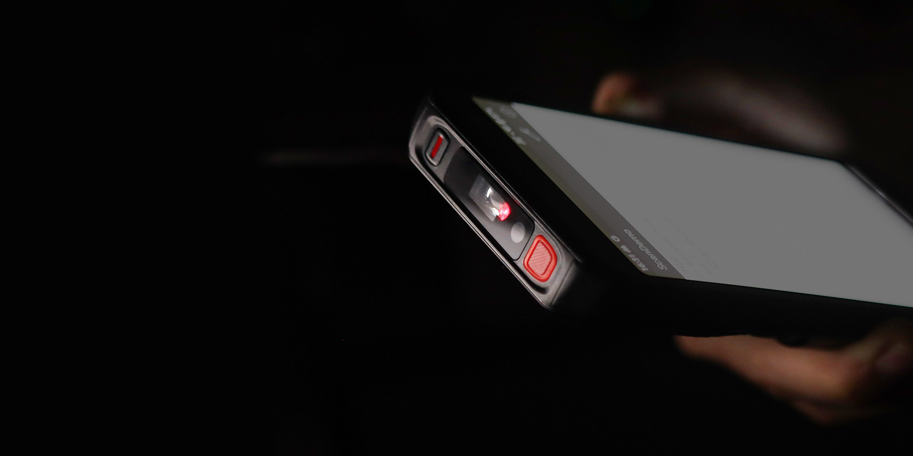
Optimized Scanning with Honeywell S0703
Intuitive Aiming: Cross Target & Framers
The high-visibility laser aimer with a cross target and framers provides an intuitive "point-and-shoot" experience. It ensures fast, precise scanning even in harsh environments, significantly reducing misreads and accelerating field workflow.
Extended Reach: Up to 573 mm (22.6 in.)
MF52e offers an exceptional reading range of up to 573 mm (22.6 in.) for UPC codes. It instantly captures damaged, low-contrast, or digital barcodes on the first try, maintaining a steady and uninterrupted workflow.
Ultra-Slim & Efficient: 7.3 mm MIPI Architecture
Modern MIPI architecture simplifies internal wiring, enabling a 7.3 mm (0.28 in.) ultra-slim engine that reduces device bulk and fatigue. This efficient design also ensures low power consumption, maximizing battery life for guaranteed full-shift productivity.

Slide 10
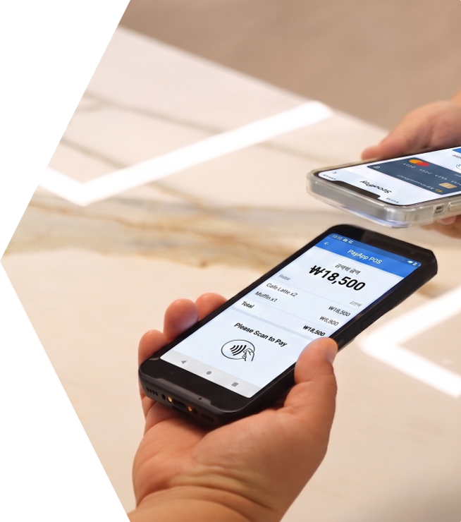
Full-Spectrum NFC Interaction Without Limits
Leveraging NFC Forum Tag Types 1 through 5, MF52e offers full-spectrum compatibility across the broadest range of standards.
From legacy tags to high-security credentials, it ensures seamless authentication, access control, and instant device pairing. Built for maximum reliability, MF52e provides a versatile foundation for any contactless enterprise workflow.

Slide 11

266.5g
16.45mm
Sleek, Lightweight, yet Powerful
At 16.45 mm Slim and 266.5g light, it’s built to fit your hand and
your pace—easy to carry through long shifts, effortless to use one-handed, and comfortable from the first scan to the last. Sleek for the counter, tough for the warehouse, and ready for every space in between—whether you’re moving fast on the floor or working steady at the frontline.

Slide 12
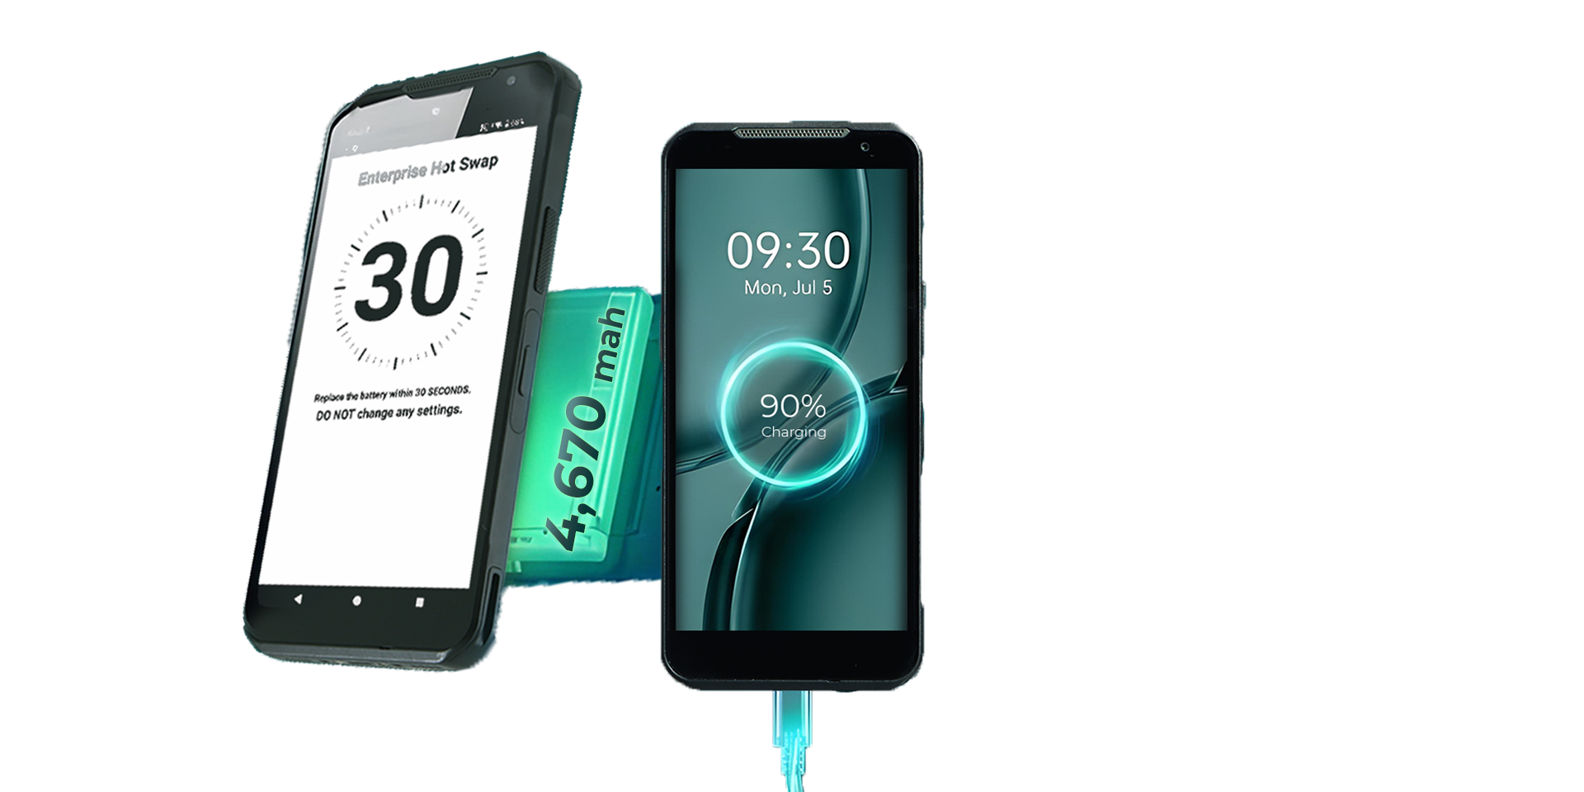
Never Wait,
Never Stop.
Hot-Swappable Battery
The 4,670 (STD) / 7,000 mAh (EXT) hot-swappable battery keeps your work moving without interruption. Even when the battery is removed, the device stays powered for up to 30 seconds.
PD 3.0 Fast Charging
With PD 3.0 fast charging, MF52e gets from 0% to 90% in just 90 minutes—keeping your device ready when your work can’t slow down. Even during demanding shifts, rapid top-ups ensure minimal downtime and maximum productivity, so your workflow stays uninterrupted.

Slide 13

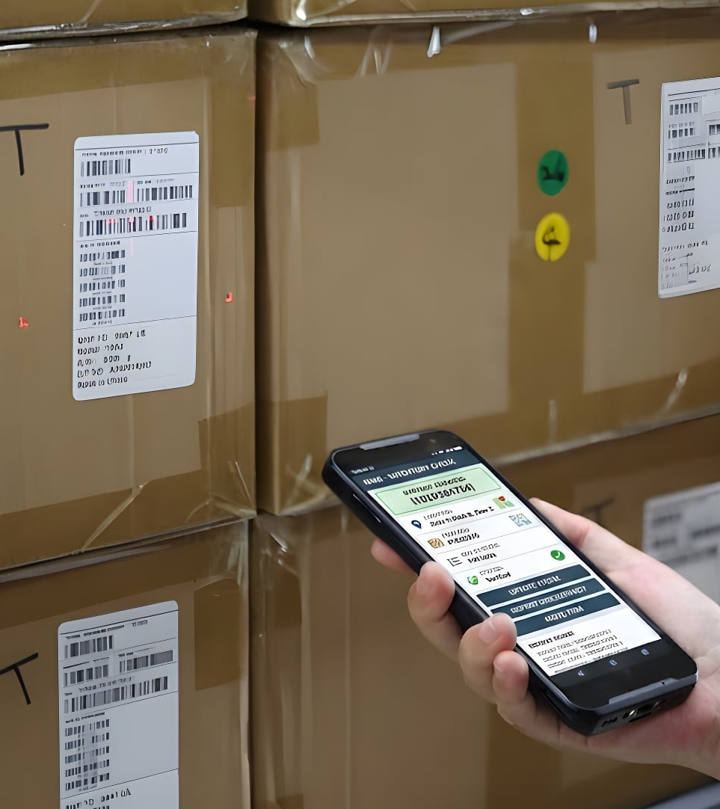
Vertical
LOGISTICS
&WAREHOUSE
RETAIL

Slide 14


Vertical
Field Service
Public Sector

Slide 15


Point Mobile Co., Ltd.
https://www.pointmobile.com/en/contactus
Tel: +82-2-3397-7870~1
ARS: 1800-3010
Fax: +82-2-3397-7872
Address: 26F, Gasan Publik,
178, Digital-ro, Geumcheon-gu,
Seoul, Korea 08513

